Slide 1
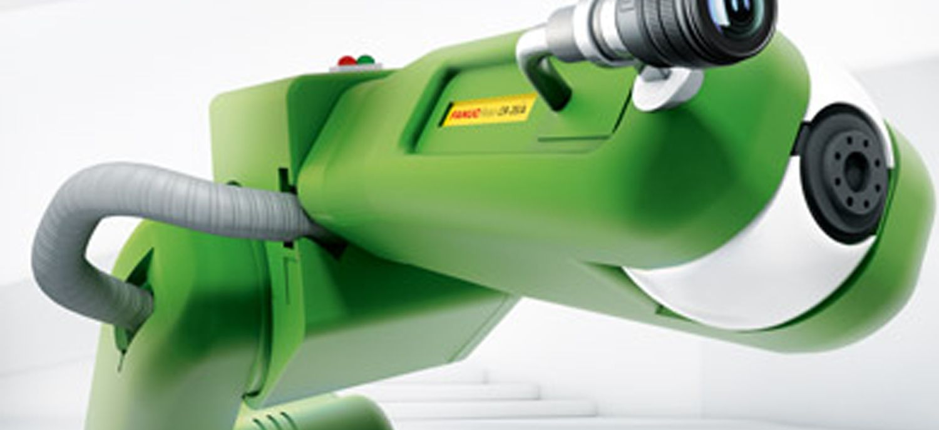
Rob 195 - Automated Object Detection in a Collaborative Robot Workspace
Bachelor Thesis Defence
Dario Aeschlimann

Slide 2
Introduction
Introduction
Current safety systems and thesis goal
Tools
Methods
Results and Outlook
Questions
Demonstration
Notes:
-Welcome
After Introduction -> Schedule

Slide 3
Current safety systems and thesis goal
Three different workspace monitoring systems:
Safety monitored stop
Speed and separation monitoring
Power and force limiting
Create an additional safety layer by implementing a vision system:
Monitor robot workspace
Detect objects
Simulate robot movements and detect collisions
Avoid collision
Notes:
Safety monitored stop: Scanners detect objects -> force robot stop, not collaborative
Speed and seperataion monitoring: detect objects and humans, different areas slower when near.
Power and force limiting: detect applied forces which lead to robot stop.
Goal of thesis

Slide 4
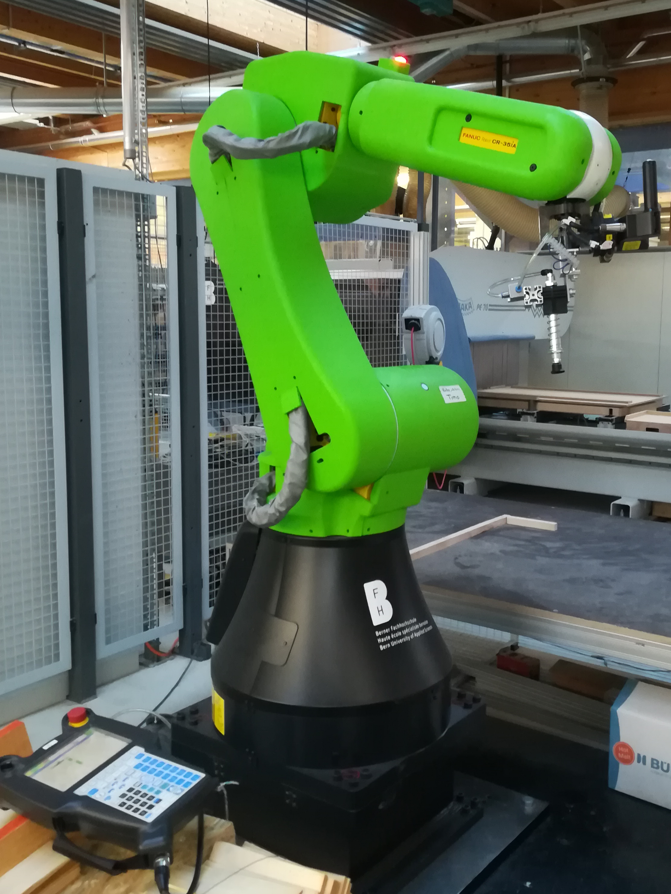
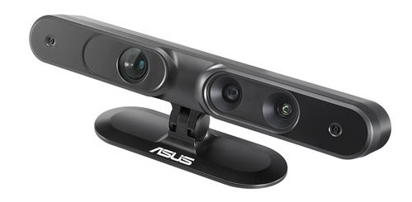
Tools
Fanuc CR-35iA Robot
Roboguide
Asus Xtion PRO LIVE
Notes:
Fanuc CR-35iA: one of the strongest, It can lift up to 35kg , reach of 1.8m
Using Roboguide the necessary KAREL and TP programs were written.
Asus Xtion PRO LIVE, RGB-D camera based on the structured light technology.
chosen becuase: was available multiple times in same version
meets the requirements
already used in similar projects

Slide 5
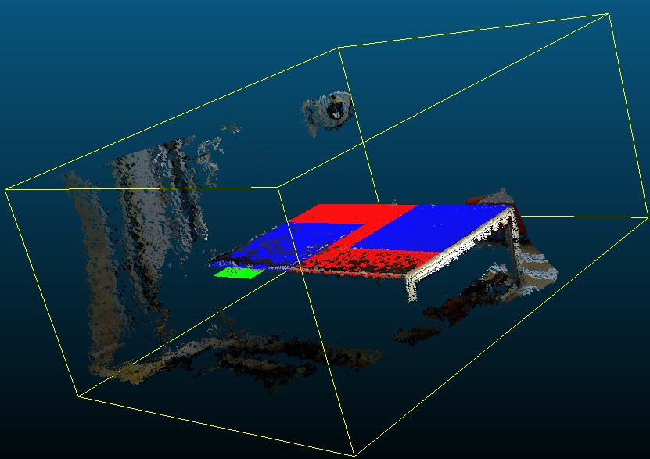
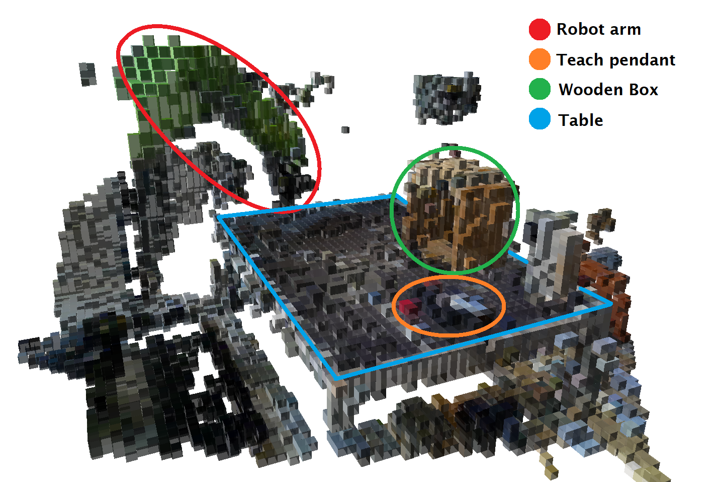
Tools
Point Cloud Library (PCL)
CloudCompare
Octomap library
Notes:
Point Cloud Library provides all necessary functionality for streaming camera data into point clouds, filtering and transforming the pointcloud. PCL is a large scale stand alone open project.
CloudCompare is an open source, point cloud processing software. In this project it is used for the camera calibration and visualisation of point clouds during development.
The octomap library provides 3D occupancy grid mapping functionalities suited for robotics.

Slide 6
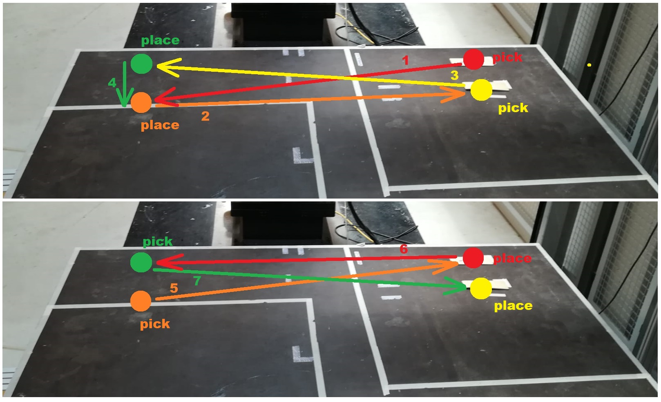
Methods
Robot communication
Socket messaging
Sequential robot communication
Telnet for gripping commands
Fieldbus alternative
Pick and Place application written in C++
Notes:
As a first task, the robot communication was implemented using socket messaging.
To keep the communication task simple, a sequential communication was implemented using the example given in the KAREL reference manual for the R-30iA controller
The gripping commands are realised using telnet commands.
Usually a communication over a fieldbus would be suggested, but no working fieldbus connection was available on the robot.
As a testing case, a basic pick and place application was implemented in C++ using the coomunication implemented beforehand. This task can be run in an endless loop.

Slide 7
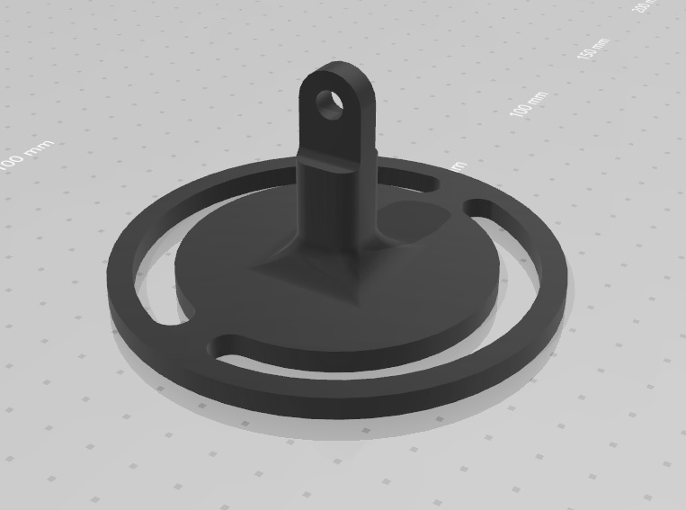
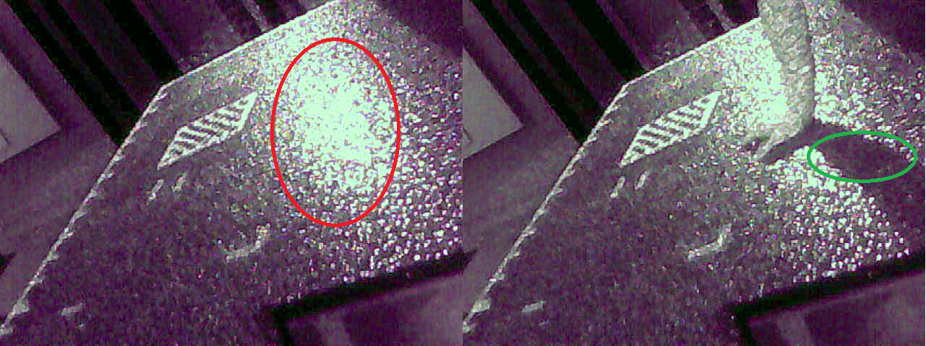
Methods
Camera positioning
Designed and 3D printed camera fixation
First mounting position directly at the table
Interference of infrared structure resulted in data loss
Maximized Distance between cameras to reduce interference
Notes:
The original camera design did not allow the camera with screws in a fixed position, thus a fixation was designed and 3D printed. The cameras were first mounted in a short ditance to the table edge.
Interference of infrared structure -> Data loss.
Increase distance between cameras to reduce infrared intensity to reduce interference

Slide 8
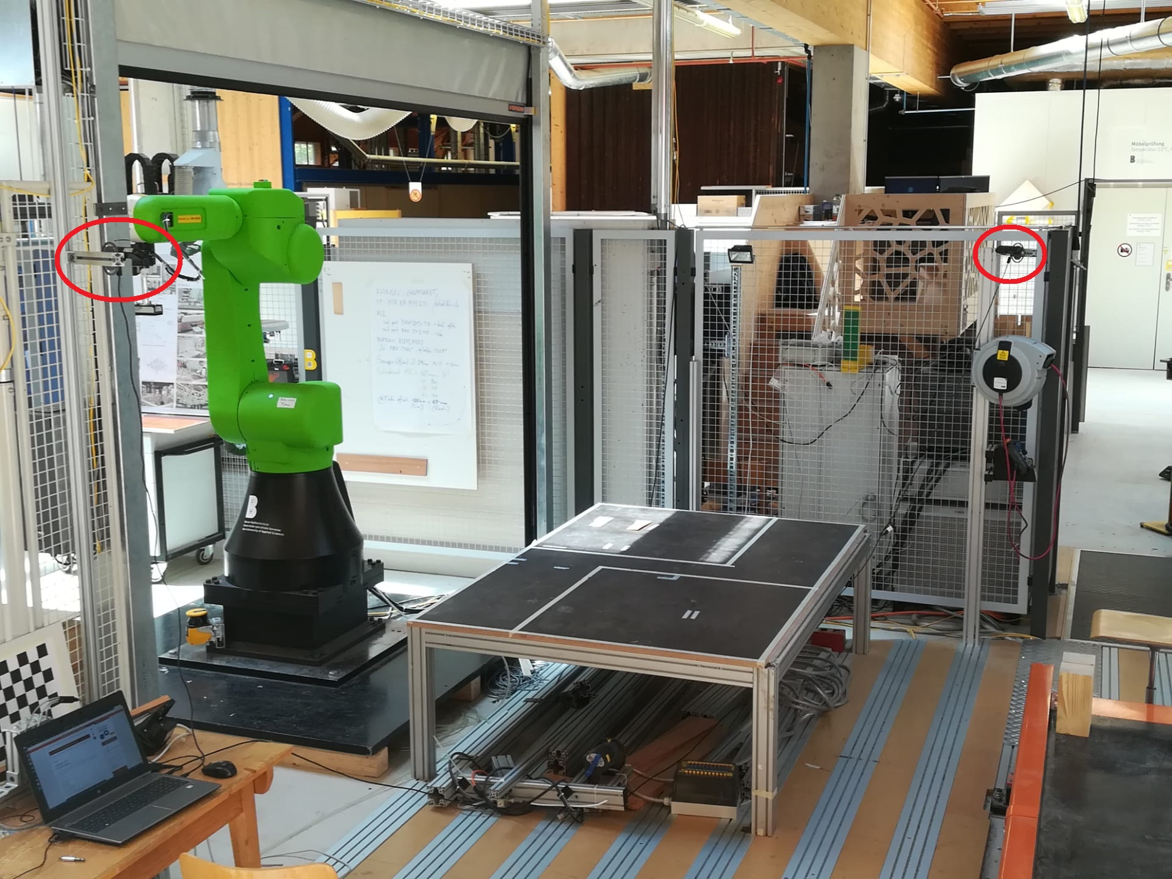
Methods
Camera positioning
Diagonal camera positioning
Provides object detection from all sides
Cameras are mounted out of reach of unintended shifting
Notes:
Diagonal camera positioning to provide a full view on all sides of the table
Additionally cameras are mounted out of reach of unintended shiftig due to bumps

Slide 9
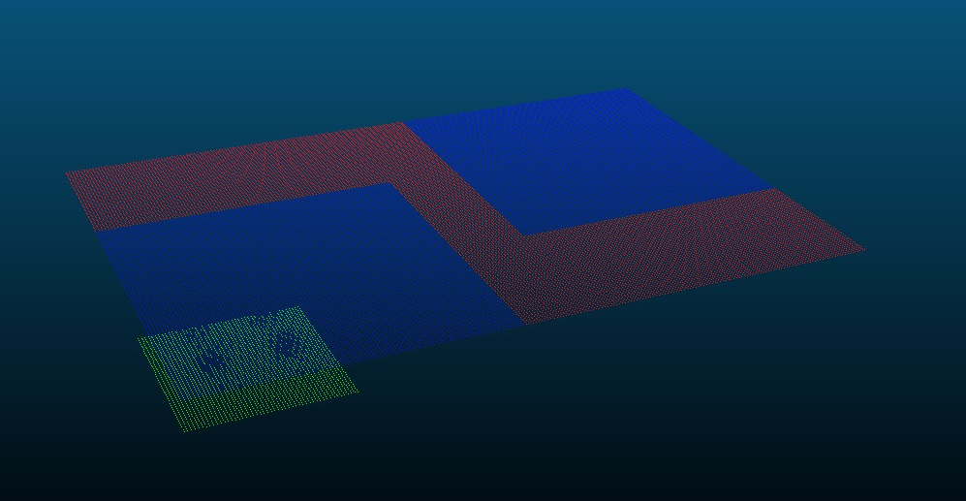
Methods
Camera calibration
Create a reference cloud of the table
Align point clouds
Save the transformation matrix
Transformation matrix will be read at system start-up
Notes:
To calibrate the camera
Create reference point cloud of table surface. Including the structure marked on the table.
Open reference point cloud and camera point clouds in CloudCompare and align with atleast 4 points of each. This generates a transformation matrix.
Transformation matrix can be copied and pasted into .txt file for later use. The System will read the transformation matrix for each camera at startup and applies it to the point cloud data.

Slide 10
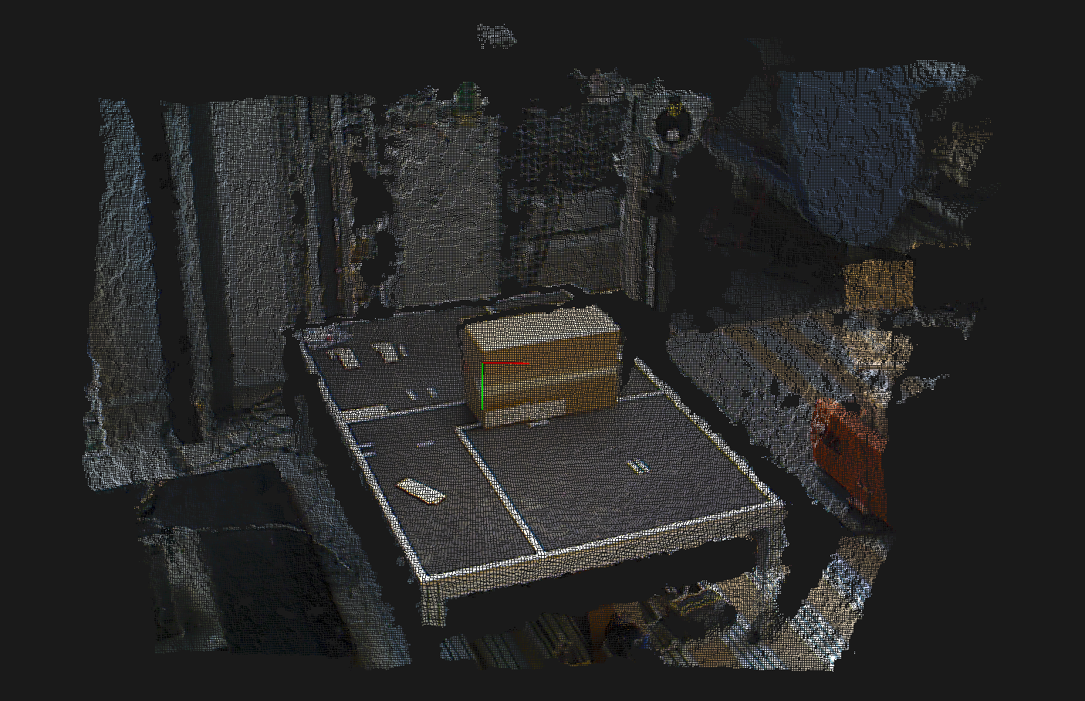
Methods
Data acquisition
Stream camera data and save data as point cloud
Applying filters
Range filter
Octree downsampling
Transform point clouds based on matrix from calibration.
Merge point clouds to single entity.
Notes:
Data stream for each camera is opened using the PCL
Each dataset is directly filtered with a range filter and the downsampled using the octree data structure.
Afterwards the point clouds are merged into a single point cloud for further processing.

Slide 11
Methods
Mapping
Generate occupancy grid out of point cloud.
Downsampling merged point cloud to desired leaf size.
Defined leaf size is 4cm.
Bigger leaf size too inaccurate
Lower leaf size too slow
Notes:
From the point cloud data an occupancy grid / voxelmap is created.
Since the merging process of the point clouds gathered with the cameras, concatenates a data set to the other, certain nodes in the voxelgrid could be represented twice.
To avoid this, the merged pointcloud is downsampled again, directly to the desired node / leaf size.
Explain leaf size.
Defined leafsize is 4cm.

Slide 12
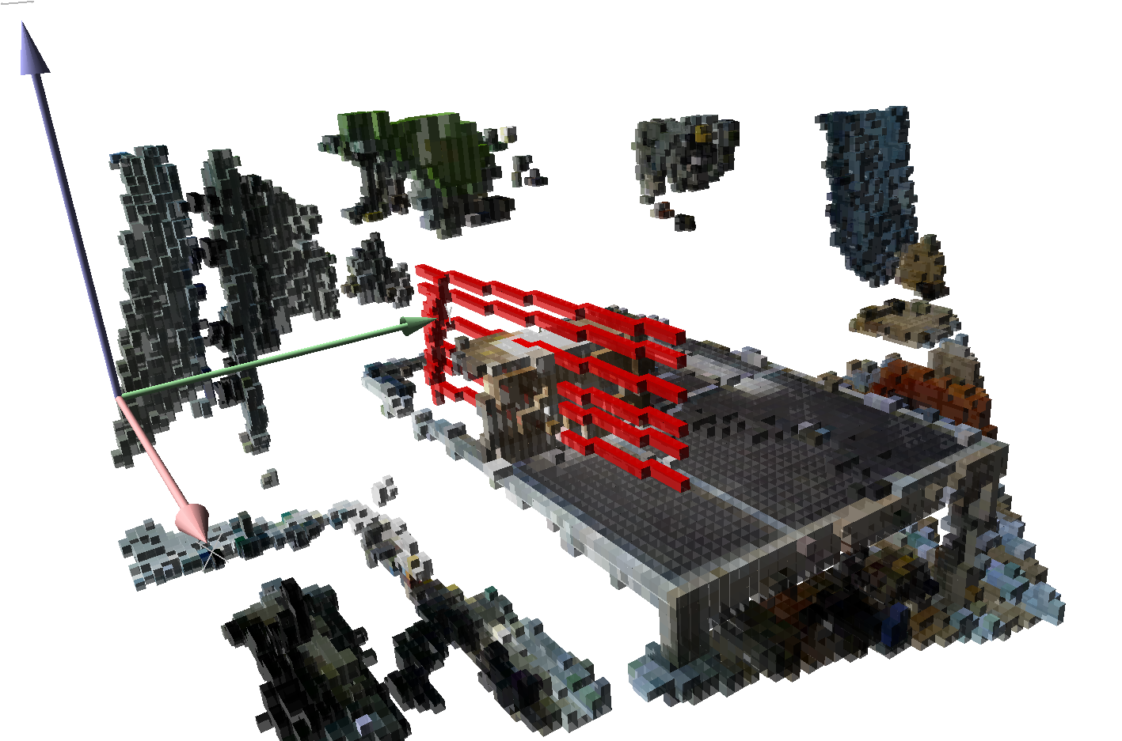
Methods
Collision Avoidance
Raycasting inside occupancy grid.
Calculate direction and distance from start to end point.
Check if ray arrives at end position without traversing any occupied cell.
Notes:
The previously generated map is used to simulate linear robot movements using raycasting.
For this, the direction and distance between the current robot position and the goal position are calucalted. Using the results a fictional line can be drawn from the start to the end position. This line stops at the first occupied cell hit. Should this not be equal to the goal position an object is in the planned path of the robot.

Slide 13
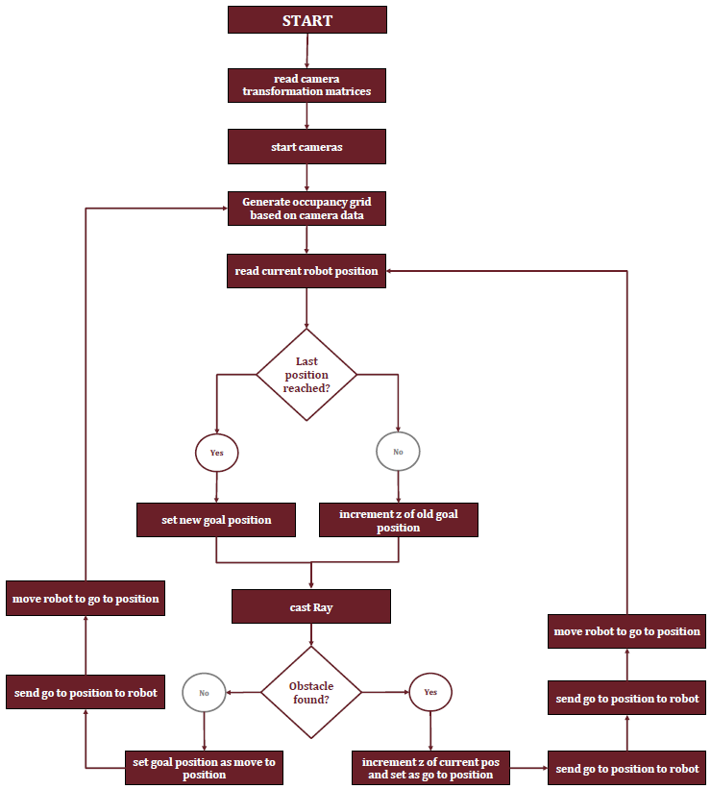
Methods
Collision Avoidance
Notes:
Explain system flow

Slide 14
Results and Outlook
Robot communication and movements
Sequential communication
Read and write cartesian positions
Upgrade to more dynamic communication by enhancing communication data with flags for read, write and move commands
Robot movements controllable from the C++ program
limited to linear movements due to raycasting
Sectioning the path in smaller parts could allow joint movements
Notes:
Dynamic communication could be reliased using each communication program on the robot as background process simultaneously. Flags send from the system to the robot could trigger read, write or movement commands.
The robot movements are currentlyx limited to linear movements since the rayCasting doesnt allow curved rays.
Collision checks of joint movements could be realised by fractioning the curved path of the robot in smaller linear sections and use the raycasting for each of this section.,

Slide 15
Results and Outlook
Cameras and data acquisition
More than two cameras needed
Shadows on certain robot positions
Data loss
Different cameras due to
Long USB cable
Interference
Segmentation of camera data to avoid having an external calibration step.
Notes:
A problem encountered several times, was that the robot casts a shadow over the workspace on certain positions. This leads to data loss and thus to flawed collision detection and avoidance, sometimes ignoring the object in the path.
This problem could be eliminated by using more than two cameras, which would lead to

Slide 16
Results and Outlook
Mapping
Map includes robot body as occupied cells
Leads to faulty collision predictions with the robot itself
Removing robot from maps would allow collision predictions in all directions.
Notes:
Currently the map includes the robot body as occupied cells.
This leads to faulty collision predictions and thus unnecessary robot movements.
Overall this could be avoided by recognizing the robot in the point cloud data and remove it from the start, which would mean
That any collision with the robot itself would be avoided.

Slide 17
Results and Outlook
Collision avoidance
Collision avoidance implemented for straight line between two points.
Only regards end-effector.
Collisions with robot body are not detected.
Collision avoidance for whole robot body necessary for industrial use.
Notes:
For now the collision avoidance system only simulates cartesian movements from the tool center point.
So collisions with objects outside that thin line of nodes would not be recognized and therefor not avoided.
Adding a collision check for the whole robot body is necessary for an industrial use of the system.
An approach to solve this problem could be to simulate the robot movements based on joint positions, adding a volume
For the robot body over the whole path.

Slide 18

Questions
Notes:
I have arrived at the end of my presentation, thank you for your attention. I would now gladly answer your questions

